Slide 1
QA From Zero to Hero
By: Michael Arias

Slide 2
¿Qué es un QA?

Slide 3

QA Engineer
Responsable por velar por la calidad del producto y el cumplimiento de los requerimientos
Notes:
Software quality assurance refers to monitoring the software engineering processes and methods used to ensure quality. Various methods are employed for this, such as ensuring conformance to one or more standards, such as ISO 9000 or a model such as CMMI. In addition, enterprise quality management software is used to correct issues such as supply chain disaggregation and to ensure regulatory compliance; these are vital for medical device manufacturers.

Slide 4
¿Qué necesita un QA?

Slide 5

Skills
1- Curiosidad
2- Habilidades Técnicas
3- Mentalidad crítica y creativa
4- Buen manejo del tiempo y prioridades
5- Comunicación

Slide 6
SCRUM

Slide 7
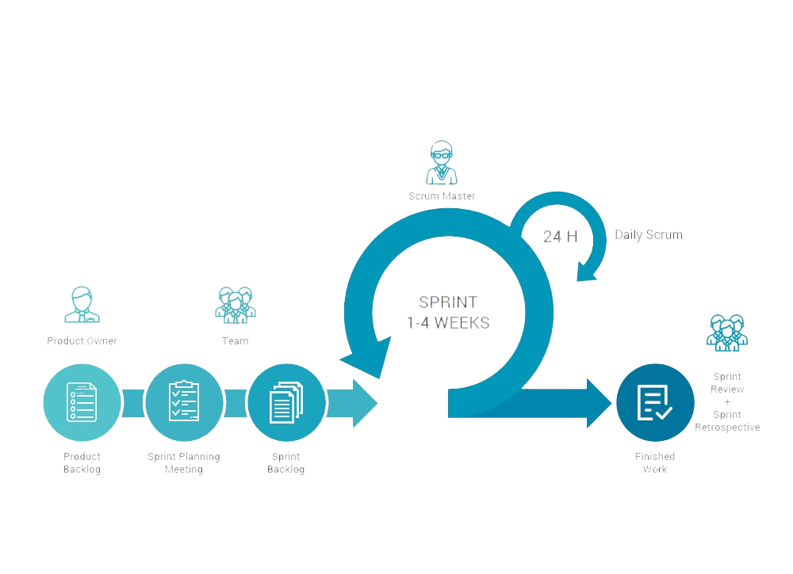
Notes:
Scrum is a framework within which people can address complex adaptive problems, while productively and creatively delivering products of the highest possible value.
Scrum is:
Lightweight
Simple to understand
Difficult to master
Events:
Sprint
Sprint Planning
Daily Scrum
Sprint Review
Sprint Retrospective
The Scrum Team consists of a Product Owner, the Development Team, and a Scrum Master.

Slide 8
Team Foundation Server

Slide 9
<<DEMO>>

Slide 10
Tipos de Pruebas
Notes:
Functional testing types include:
Unit testing
Integration testing
System testing
Sanity testing
Smoke testing
Interface testing
Regression testing
Beta/Acceptance testing
Non-functional testing types include:
Performance Testing
Load testing
Stress testing
Volume testing
Security testing
Compatibility testing
Install testing
Recovery testing
Reliability testing
Usability testing
Compliance testing
Localization testing

Slide 11

White Box
Notes:
White Box testing is based on the knowledge about the internal logic of an application’s code.
It is also known as Glass box Testing. Internal software and code working should be known for performing this type of testing. Under these tests are based on the coverage of code statements, branches, paths, conditions etc.

Slide 12

Unit Testing
Notes:
Testing of an individual software component or module is termed as Unit Testing. It is typically done by the programmer and not by testers, as it requires a detailed knowledge of the internal program design and code. It may also require developing test driver modules or test harnesses.

Slide 13

Integration Testing
Notes:
Testing of all integrated modules to verify the combined functionality after integration is termed as Integration Testing. Modules are typically code modules, individual applications, client and server applications on a network, etc. This type of testing is especially relevant to client/server and distributed systems.

Slide 14
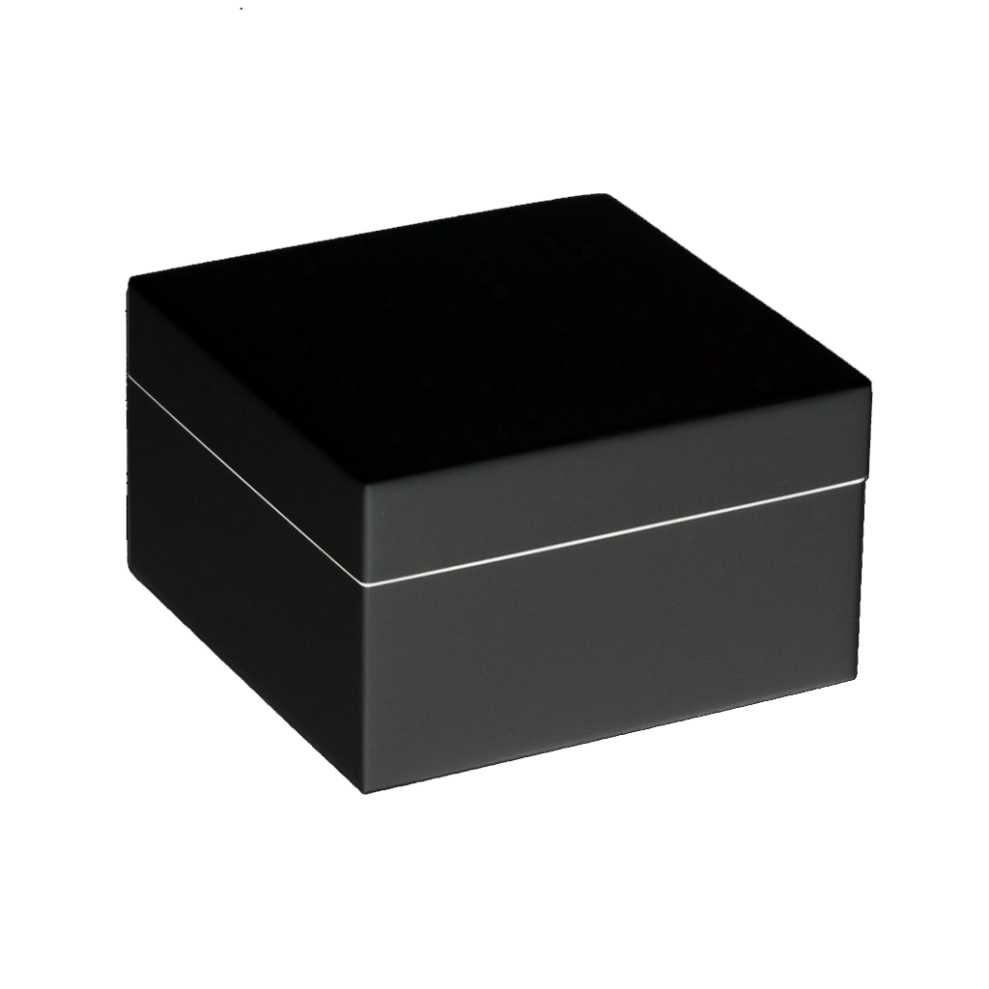
Black Box
Notes:
Internal system design is not considered in this type of testing. Tests are based on the requirements and functionality.
Detailed information about the advantages, disadvantages, and types of Black box testing can be seen here.

Slide 15

Smoke Testing
Notes:
Whenever a new build is provided by the development team then the software testing team validates the build and ensures that no major issue exists.
The testing team ensures that the build is stable and a detailed level of testing is carried out further. Smoke Testing checks that no show stopper defect exists in the build which will prevent the testing team to test the application in detail.
If testers find that the major critical functionality is broken down at the initial stage itself then testing team can reject the build and inform accordingly to the development team. Smoke Testing is carried out to a detailed level of any functional or regression testing.

Slide 16
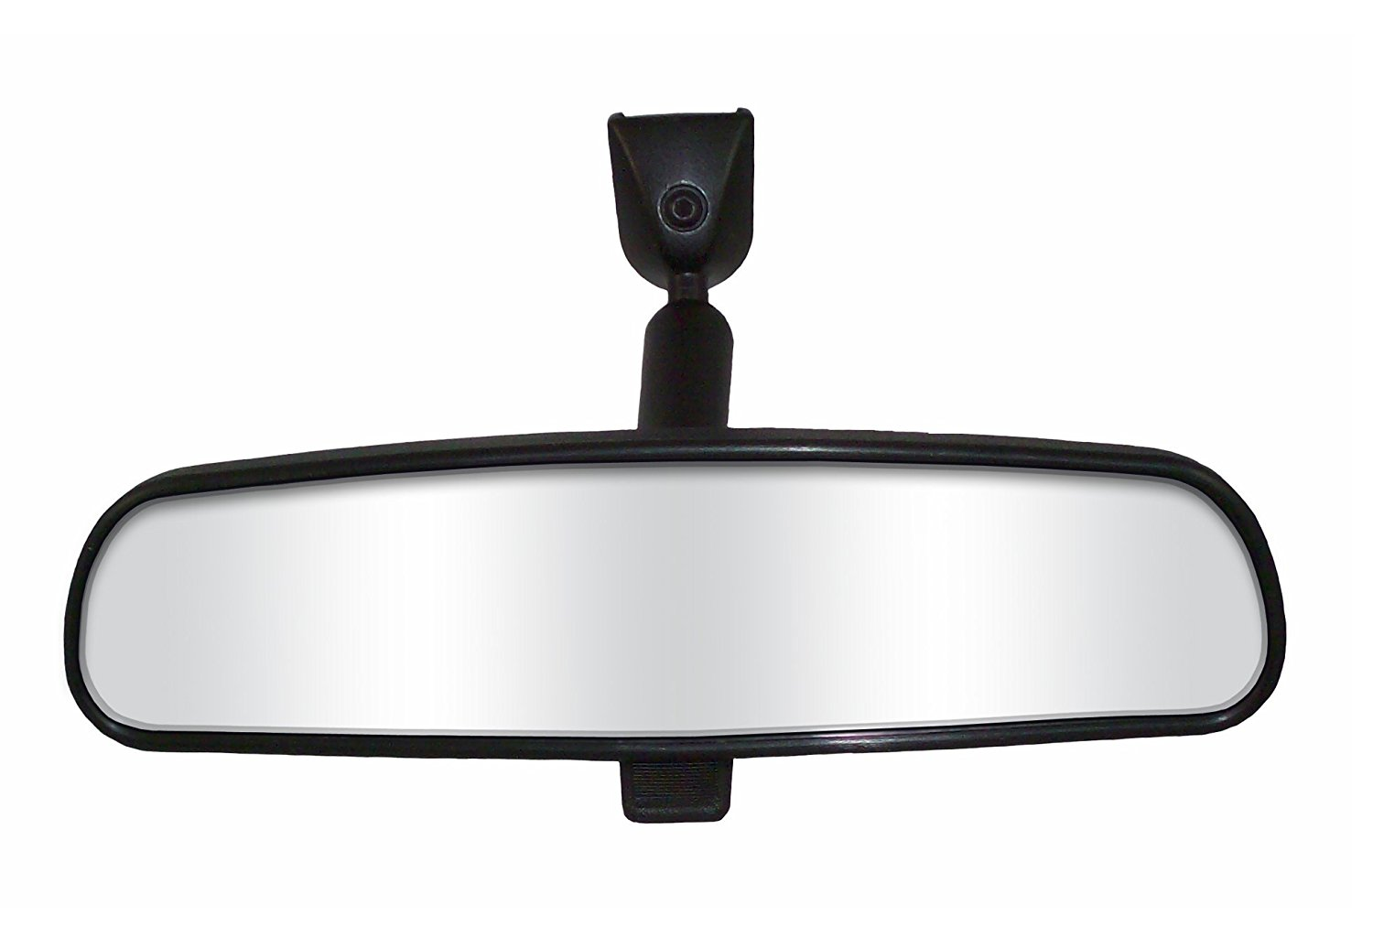
Regression Testing
Notes:
Testing an application as a whole for the modification in any module or functionality is termed as Regression Testing. It is difficult to cover all the system in Regression Testing, so typically automation testing tools are used for these types of testing.

Slide 17

Happy Path Testing
Notes:
The objective of Happy Path Testing is to test an application successfully on a positive flow. It does not look for negative or error conditions. The focus is only on the valid and positive inputs through which application generates the expected output.

Slide 18

Negative Testing
Notes:
Testers having the mindset of “attitude to break” and using negative testing they validate that if system or application breaks. A negative testing technique is performed using incorrect data, invalid data or input. It validates that if the system throws an error of invalid input and behaves as expected.

Slide 19

Exploratory Testing
Notes:
Exploratory Testing is informal testing performed by the testing team. The objective of this testing is to explore the application and looking for defects that exist in the application. Sometimes it may happen that during this testing major defect discovered can even cause system failure.
During exploratory testing, it is advisable to keep a track of what flow you have tested and what activity you did before the start of the specific flow.
An exploratory testing technique is performed without documentation and test cases.

Slide 20
Y muchos… Muchos más.

Slide 21
Microsoft Test Manager Release Management

Slide 22
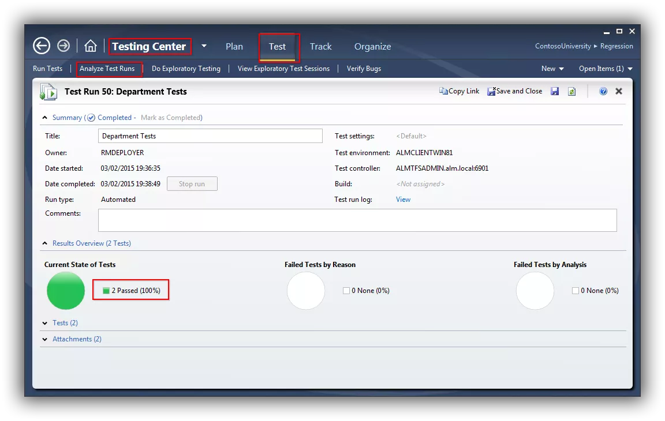
Como solía ser...

Slide 23
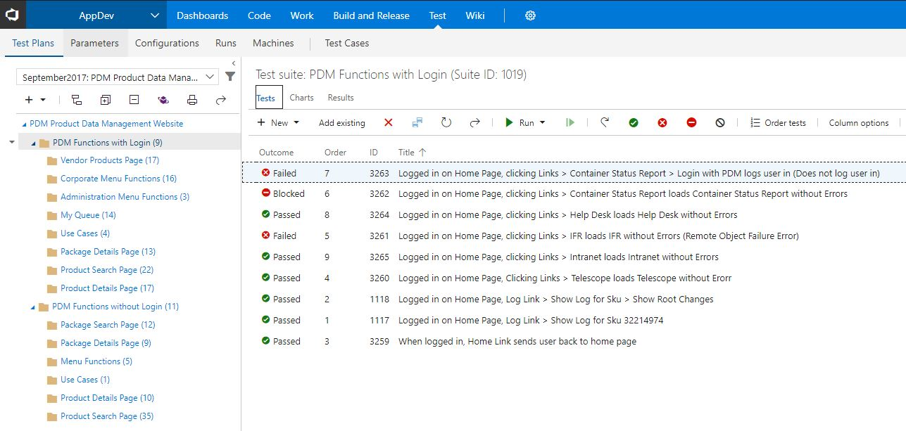
Como es...

Slide 24
Selenium
Notes:
Selenium is a free (open source) automated testing suite for web applications across different browsers and platforms. It is quite similar to HP Quick Test Pro (QTP now UFT) only that Selenium focuses on automating web-based applications. Testing done using Selenium tool is usually referred as Selenium Testing.

Slide 25
<<DEMO>>

Slide 26
Tips and Tricks

Slide 27




Tecnologías más usadas

Slide 28



¿Dónde seguir aprendiendo?
Notes:
https://www.pluralsight.com/ - John Sonmez
https://qaboy.com
http://makeseleniumeasy.com/

Slide 29



¿Dónde aplicar?

Slide 30
QABOY.COM
Notes:
Bibliography:
https://www.scrum.org/resources/what-is-scrum
https://www.softwaretestinghelp.com/types-of-software-testing/
https://www.guru99.com/introduction-to-selenium.html

